Slide 1
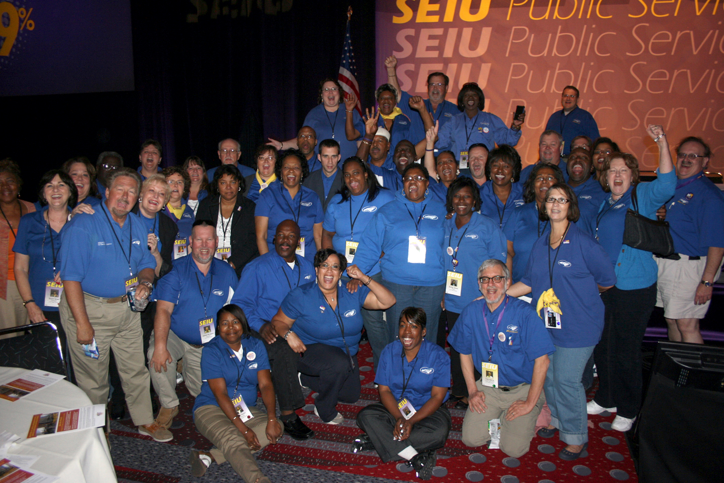


Slide 2


WHO ARE WE?
“The South’s Leading State Employees’ Association”
70+
45,000⁺
members
Years
strong
Notes:
We are the State Employees Association of North Carolina. We are the association that advocates on behalf of state employees inside the General Assembly. SEANC is a member led association with 51 districts across the state of NC. We have full time lobbyists that make up our Government Relations team. We are fortunate to have Suzanne Beasley, Director of Government Relations on the call tonight to give you some legislative updates.

Slide 3
MISSION
SEANC is committed to protecting and enhancing the rights and benefits of current, retired and future state employees.

Slide 4
WHY YOU SHOULD JOIN
Full-time lobbyists advocating for you
Low-cost insurance programs
Member discount program
Purchasing Power
College scholarships
Publications and alerts
EMPAC
$1,000 Accident Policy

Slide 5

SEANC INSURANCE PRODUCTS
Accident
Accidental Death & Dismemberment
Auto/Home
Cancer Critical Illness with Cancer
Critical Illness and Trauma
Dental / Vision
Disability
Final Expense/ Whole Life
Hospital Confinement Indemnity
MetLife Legal Plan
Identity Protection
Long-term Care
Pet
Permanent/Whole Life
Term Life
Notes:
Here is a list of all the products that SEANC offers to its members.

Slide 6

Benefits of a SEANC plan
Year-round enrollment – 24/7, 365 days a year!
You choose how to apply; online, over the phone or mail or fax your application to SEANC
You can keep coverage when you retire
SEANC supports your family dependents, including Domestic Partner, Spouse and children up to age 25
No waiting periods once your plan is in force.
Life insurance without medical questions
$1,000 AD&D Policy for all members

Slide 7

View Insurance Guide
seanc.org/insuranceguide

Slide 8

DISCOUNTS
3,200 MEMBER DISCOUNTS

Slide 9
PERKS CONNECT APP

Slide 10

THEME PARK TICKETS

Slide 11


PURCHASING POWER

Slide 12
SCHOLARSHIP

Slide 13
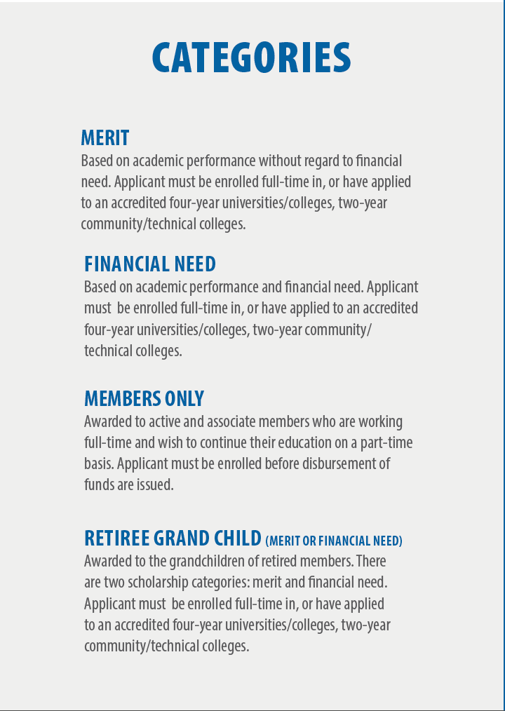
Scholarship Categories

Slide 14

Leadership NC Scholarship
SEANC’s Emerging Leaders Council has established a scholarship program to allow one SEANC member the opportunity to participate in Leadership North Carolina (LNC), a two-year training program where participants acquire the skills necessary to take the lead. Apply by April 30.

Slide 15
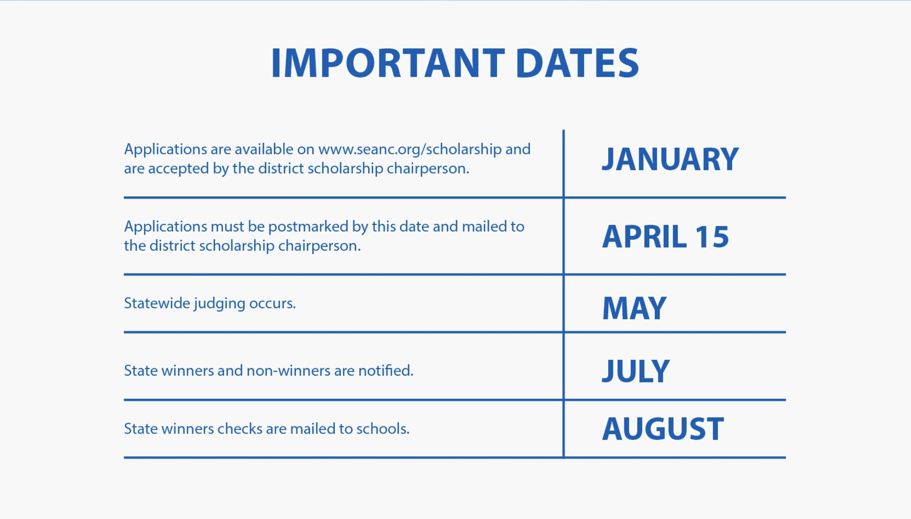
Purchasing Power

Slide 16



PUBLICATIONS & ALERTS
Newsletter mailed 4
times per year
Weekly e-newsletter
Text alerts

Slide 17

State employees organized to raise money for candidates who support quality public services
91% of EMPAC-endorsed legislative candidates were elected in 2016, including Governor Roy Cooper and Treasurer Dale Folwell

Slide 18
APPLICATION

Slide 19
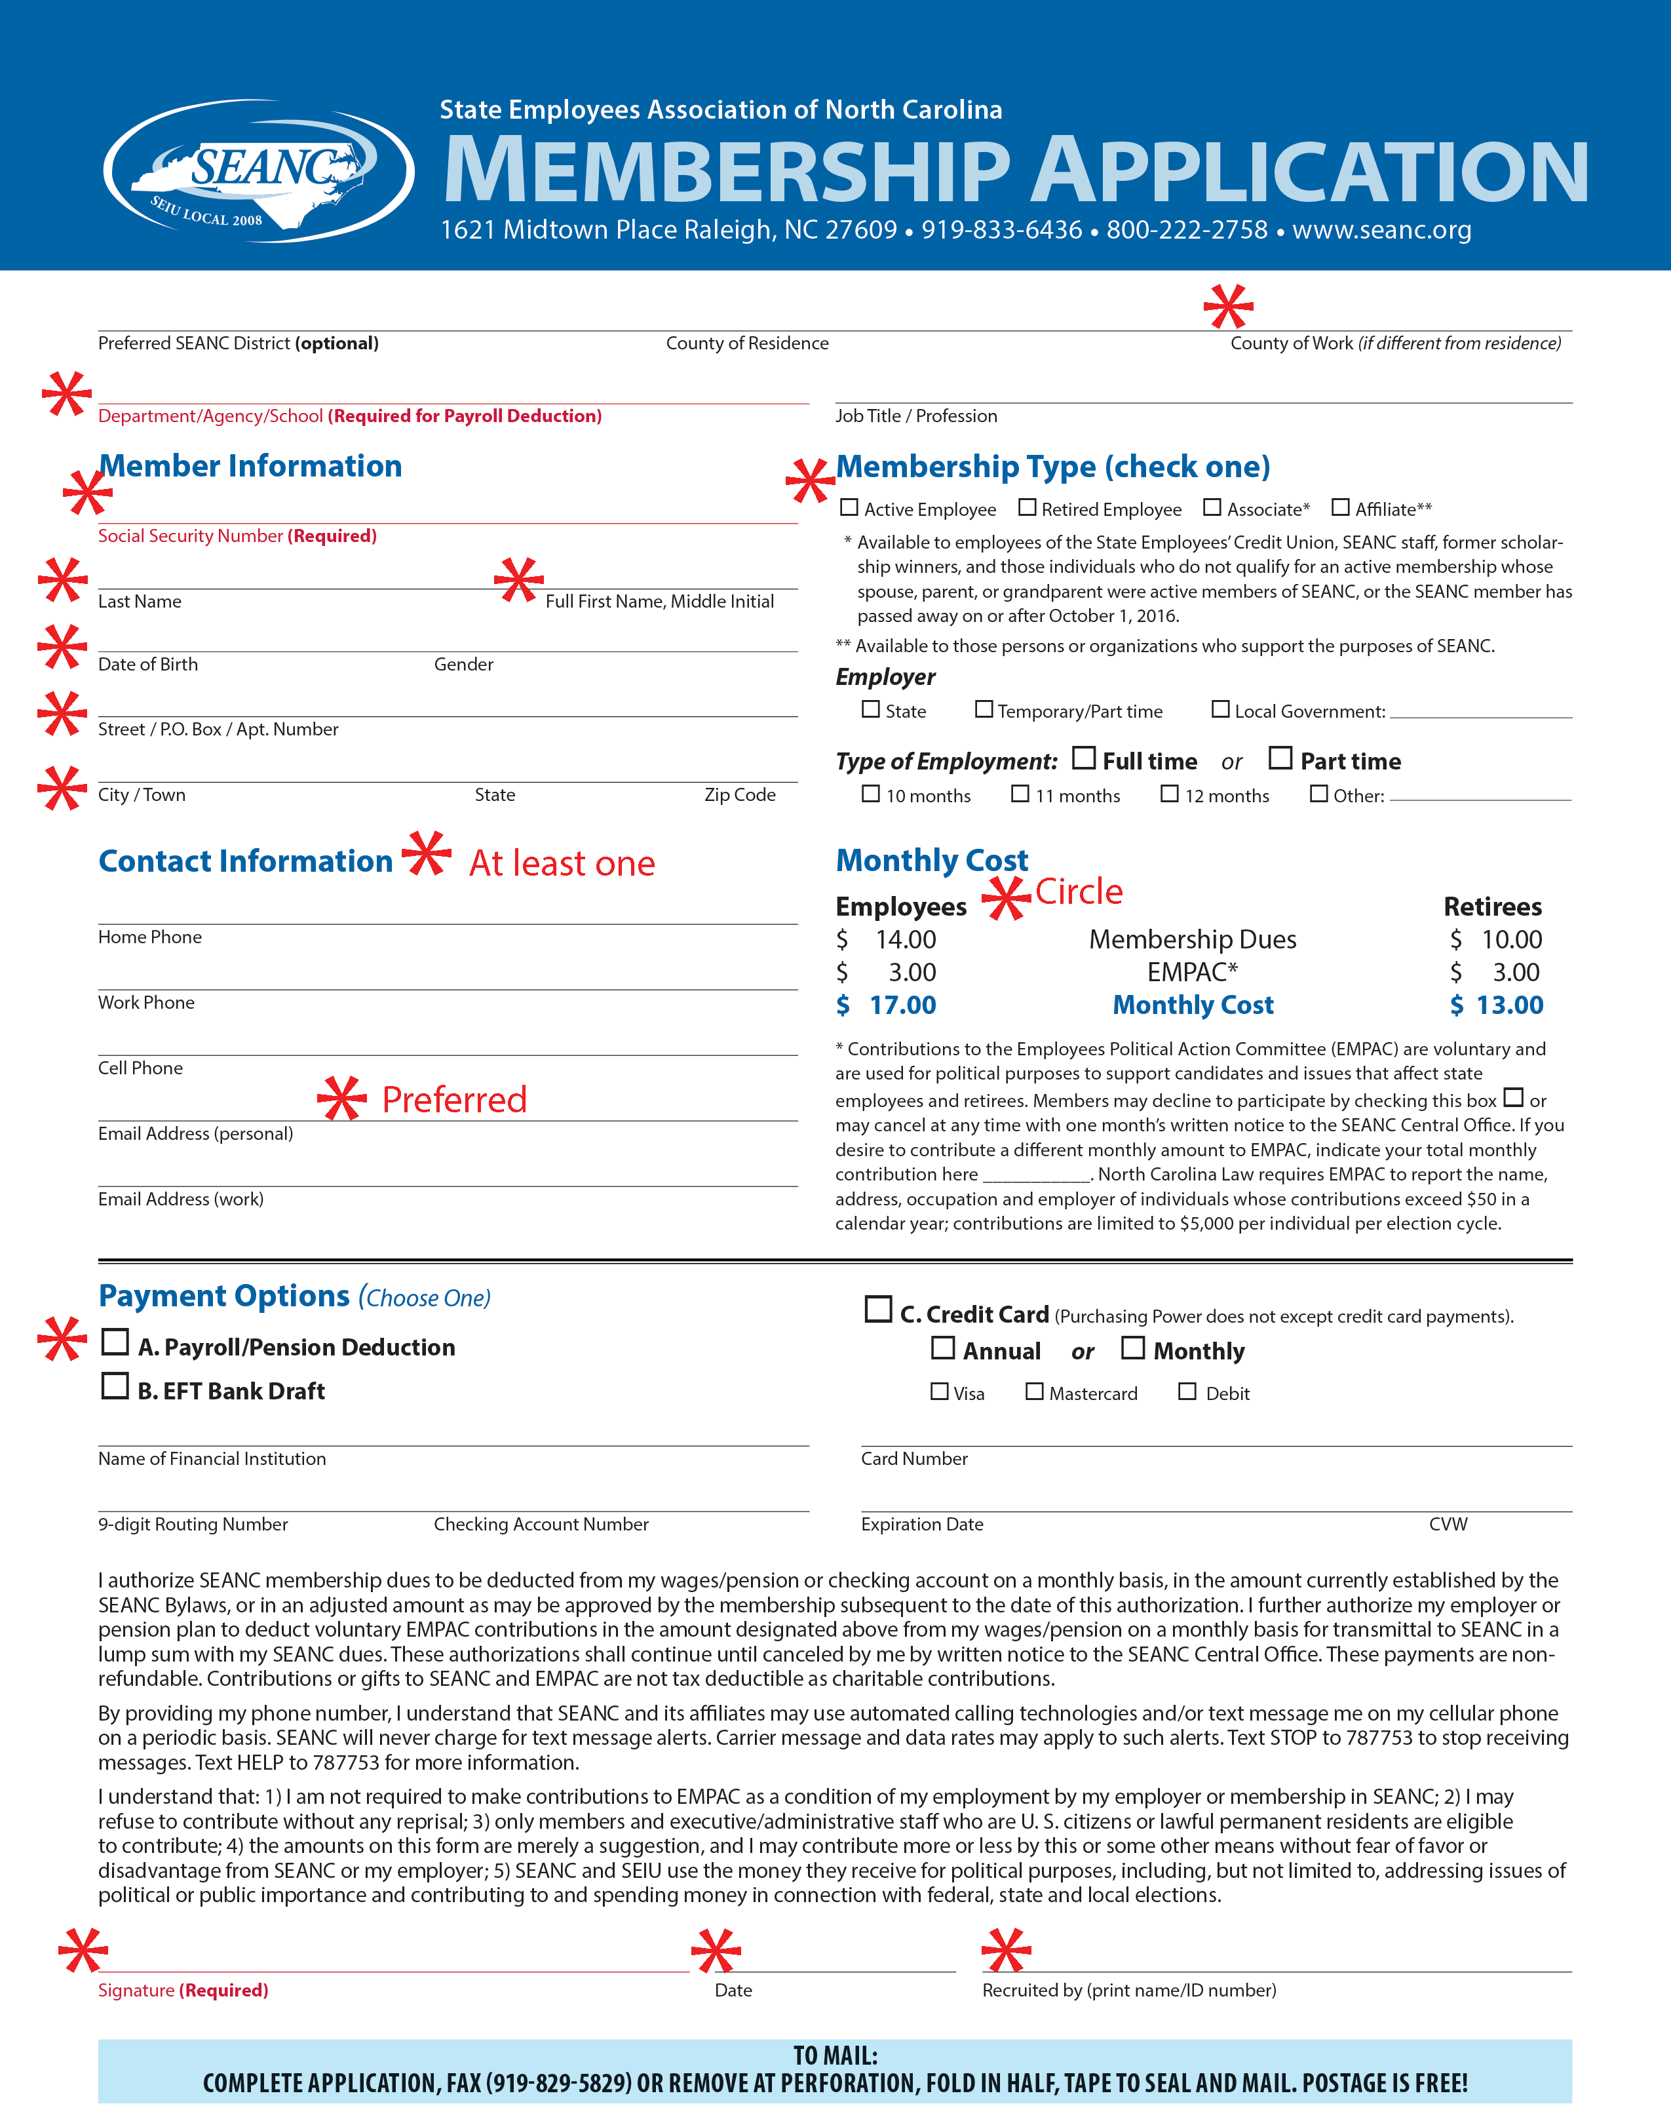

Slide 20
Notes:
Approximately how many state employees are there in North Carolina? 81,148
Average years of service for state employees? 11
Why was SEANC formed? DOT story
What is the average age of the NC state employee? 47
How many districts does SEANC have? 51

Slide 21
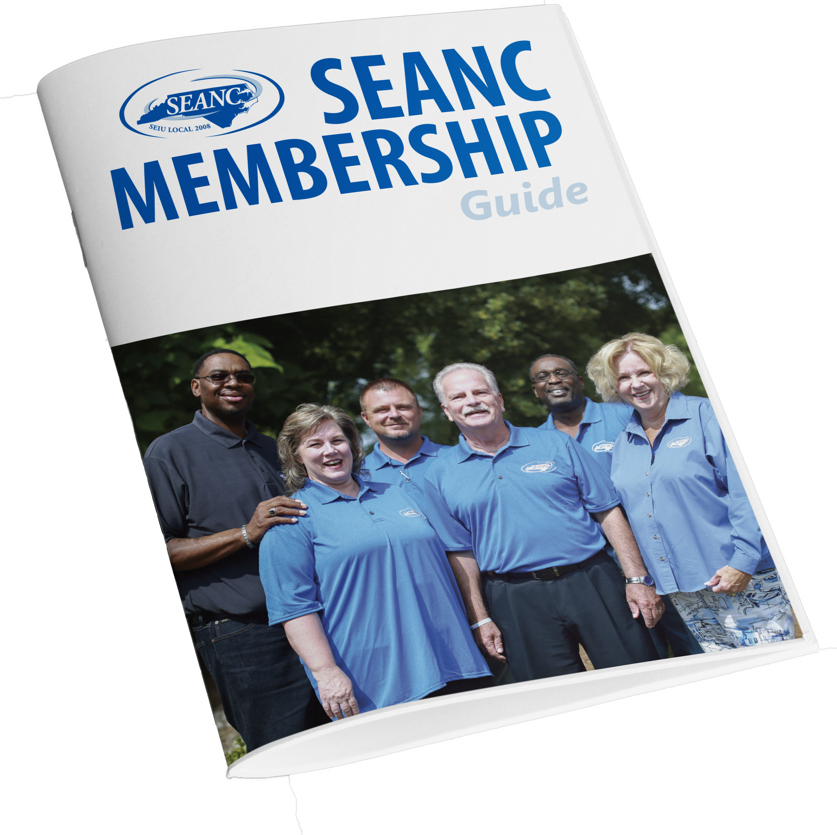
View Member Guide
seanc.org/memberguide

